Slide 1




Eniac - entry market
Partnership with Magist in the Brazilian market

Slide 2



Is Magist a good fit for high-end tech products?
1. Bed, bath and table
2. Health and beauty
3. Sports and leisure
9,8%
8,5%
7,6%
Computer and accessories are in the 5th position with 6,9% of the orders.
High end tech products are not the platform’s core business.

Slide 3


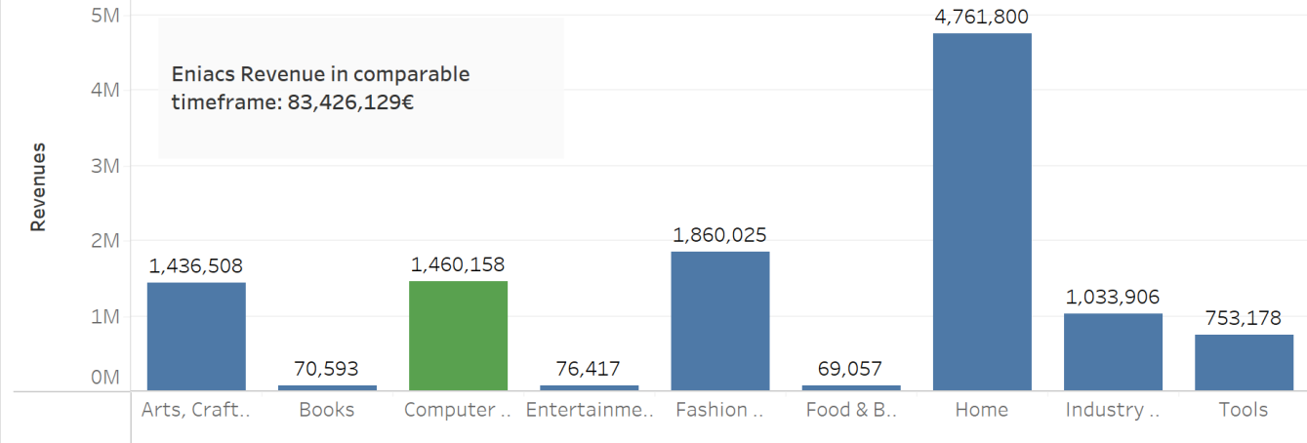
Magist’s revenue
Magist has around 57 times less revenue in computer and accessories than Eniac’s.

Slide 4


3,7 %
of electronic sales of Magist’s is total 500 Euros or more.
Eniacs average order is 710 Euros.

Slide 5
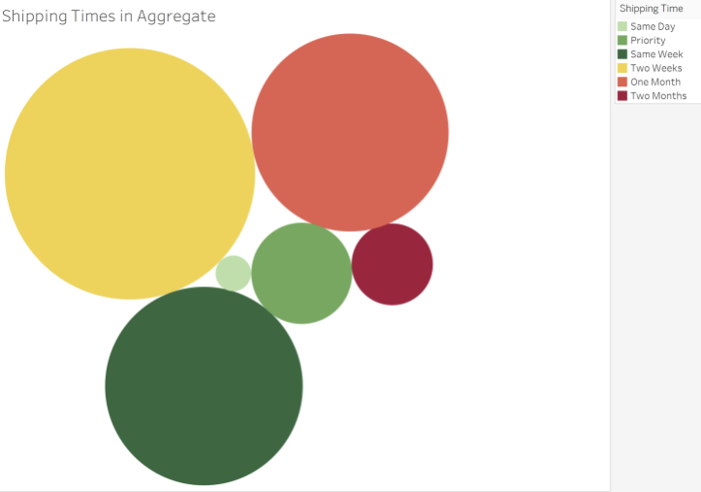
Delivery time from Magist’s orders
Deliveries from magist take on average 2 weeks.
Fast deliveries (within 1 week or faster) are only 31,8% of total.

Slide 6

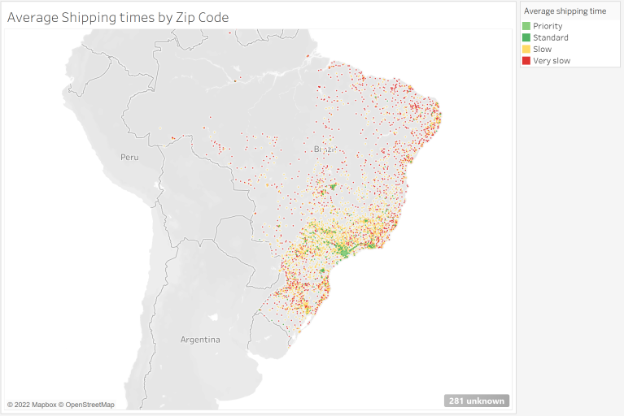
Are the deliveries fast enough?
No, the mail service in Brazil are not fast enough to meet eniac's strategy.
In Sao Paulo region it would be acceptable, but if we considerate the whole country, deliveries are very slow.

Slide 7


Our recommendations
Start only in the Sao Paulo region
The average delivery time in Sao Paulo region is quite acceptable and meets Eniac's strategy.
Platform focused in high end products only
Focusing on a platform only for high end products will enable Eniac to access only relevant users, instead of a huge platform like magist.

Slide 8

Thank you for your attention

